Slide 1
Cell Metabolism And Homeostasis
By
Dr. G. Praveen Kumar

Slide 2
Basics of Metabolism
Metabolism is a network of metabolic / biochemical reactions.
Metabolism:
Sum of all chemical reactions that occur in the body
Require the use of enzymes and coenzymes
Carried out in living cells.
Related to various biomolecules
Carbohydrates
Lipids
Proteins
Nucleoproteins

Slide 3
Metabolism involves inter conversions of chemical compounds in the body.
Metabolite precursors are transformed to end products via many specific intermediates.
Metabolism is the sum of the chemical changes that convert:
Nutrients into energy.
Chemically complex substances of cells into simpler forms.
Chemically simple substances into functional complex biomolecules.

Slide 4
Types Of Metabolic Pathway
Catabolic pathway
Breaks down complex molecules into simpler ones
Ex. Digestion of the food
Anabolic pathway
Builds complex molecules from simple ones
Ex. Production of new body tissues

Slide 5
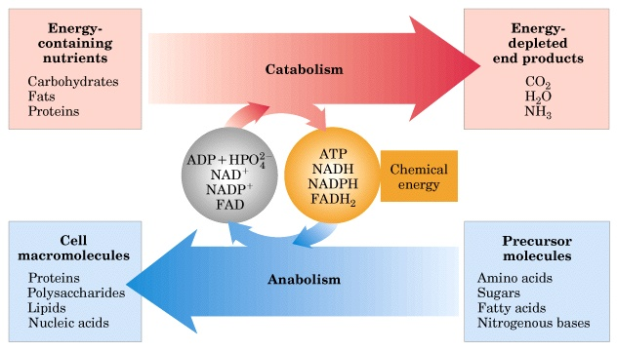

Slide 6
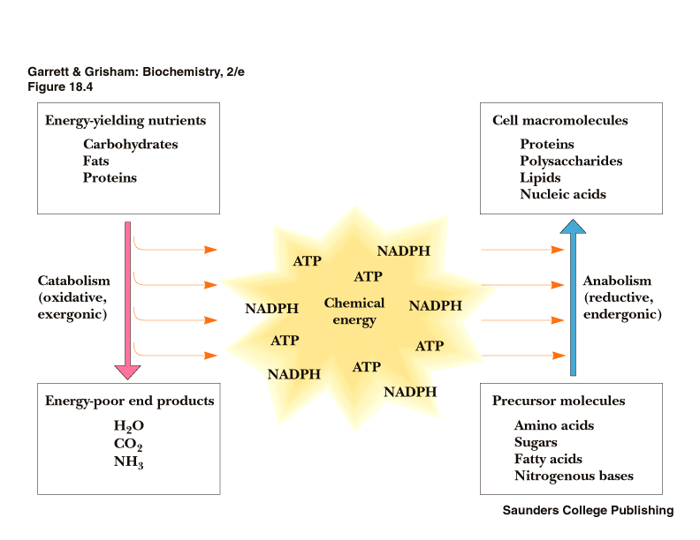

Slide 7
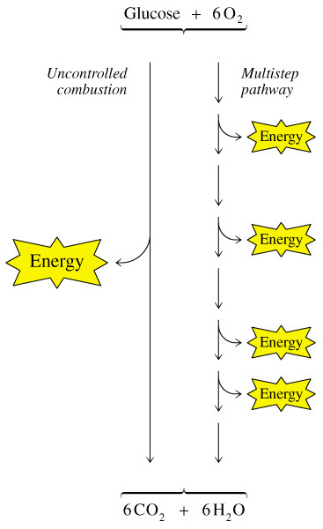
Example of Catabolism: Cellular respiration
Overall reaction for cellular respiration is:
C₆H₁₂O₆ (s) + 6 O₂ (g) → 6 CO₂ (g) + 6 H₂O (l) + heat

Slide 8
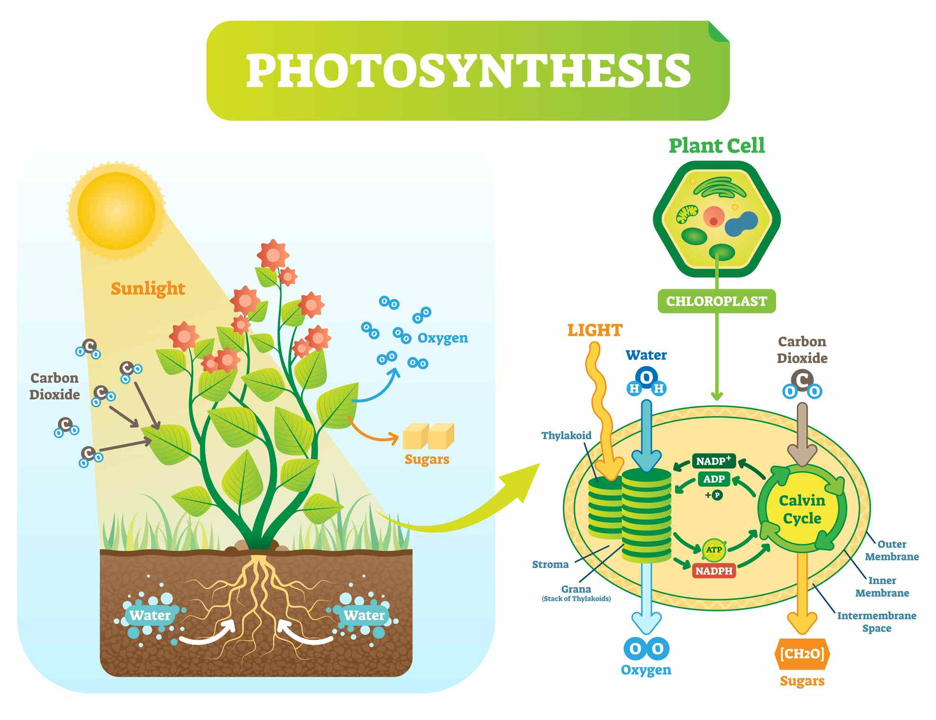
Example of Anabolism: Photosynthesis
Overall reaction for photosynthesis
6CO₂+6H₂O C₆H₁₂O₆+6O₂

Slide 9
Regulation of Metabolic Pathways
Nutrient availability
Adapt quantitatively to the supply of a nutrient at a specific site
For example, Milk coagulating enzyme rennin which is present in the gastric mucosa
Transport of the Nutrient
Availability of substrate or nutrient into a cell can be regulated by controlling the transport of the nutrients across the cell membrane.
For example, insulin regulates carbohydrate metabolism by facilitating the transport of glucose into the cells.

Slide 10
Quantity of Enzyme
Amount of enzyme available for a catalytic reaction may be controlled genetically by induction or repression
e.g. adrenoglucocorticoid hormones.
Control of Endocrine
Metabolic reactions are controlled by the secretion of hormones in many ways
Example. Insulin
Control of the Neural Coordination
Various effects of nerve stimulation on metabolic pathways are probably indirect by hormonal or other mechanisms.

Slide 11
Homeostasis

Slide 12
Introduction of Homeostasis
Homeostasis is the tendency to resist change in order to maintain a stable state, relatively constant internal environment.
Homeostasis typically involves negative feedback loops that counteract changes of various properties from their target values, known as set points.
In contrast to negative feedback loops, positive feedback loops amplify their initiating stimuli, in other words, they move the system away from its starting state.

Slide 13
Regulation of homeostasis by Negative feedback
Change in a factor (controlled variable) triggers a physiological response that seeks to restore the factor by opposing the initial change
Example. control of room / body temperature
Three components of a control system
Sensor (receptor)– monitors the control variable (for example, room temp.)
Integrating (control) center– it compares the sensor’s input with the set point and sends instructions to effector
Effector– action component

Slide 14
Thermo-Regulator
Body temperature is monitored and controlled by temperature receptors in the skin and brain.
These receptors detect changes in the temperature of blood flowing through those areas.
The thermoregulatory centre in the brain is called the hypothalamus.
If body temperature deviates from 37 °C, the hypothalamus and skin receptors send out electrical signals that trigger actions or behaviours that increase or decrease heat loss.

Slide 15
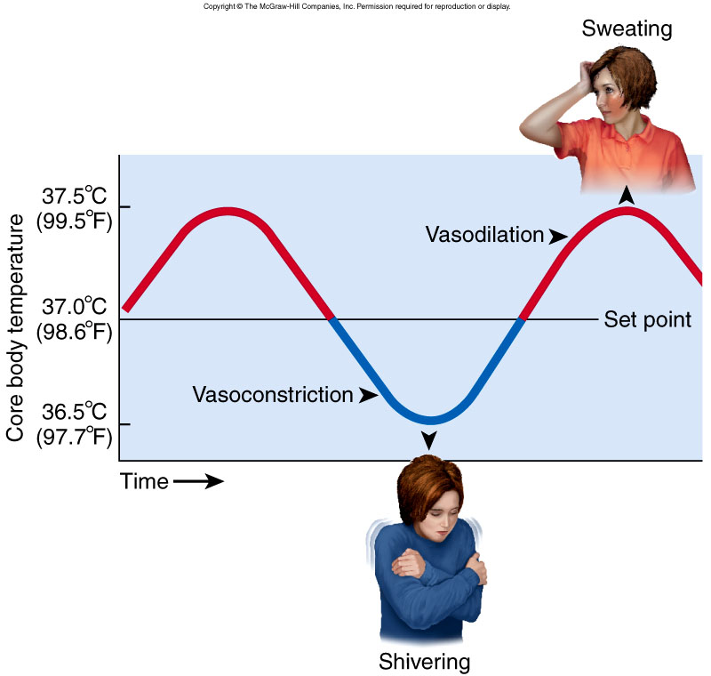

Slide 16
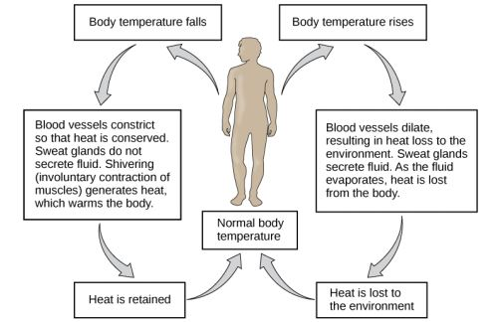
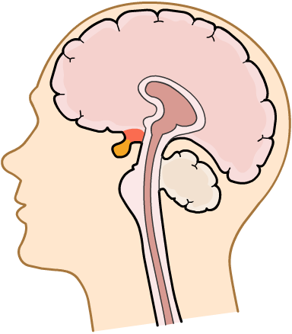
hypothalamus

Slide 17

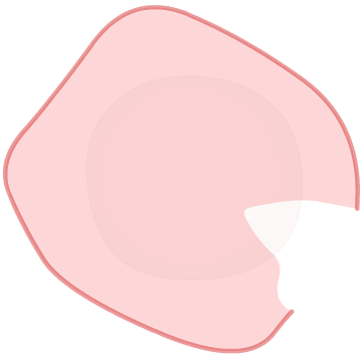
Gluco-Regulator
Glucose is a type of sugar used by the body to provide energy.
What affects the level of blood glucose?
Eating causes blood glucose levels to rise.
Vigorous exercise causes blood glucose levels to fall.
Excess glucose makes the blood plasma and tissue fluid around cells too concentrated. This can severely damage cells, for example, causing crenation in red blood cells.
However, low blood sugar levels can be equally as dangerous, as it can make cells swell up and burst. This is called lysis.

Slide 18
Pancreas produces and releases different hormones depending on the blood glucose level.
Insulin is released when blood glucose levels are high – the liver stores excess glucose as glycogen (anabolic)
Glucagon is released when blood glucose levels are low – the liver converts stored glycogen into glucose and releases it into the blood (catabolic)

Slide 19
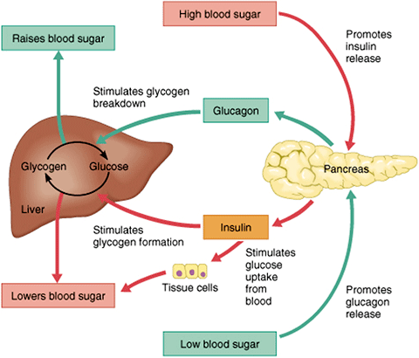
BLOOD GLUCOSE CONTROL

Slide 20
Positive Feedback
Change in a factor triggers a physiological response that amplifies an initial change
Example— in the birth of a baby
Details of birth of a baby
Uterine contractions push the baby against the cervix
Stretching of the cervix triggers nerve impulses
Brings about oxytocin secretion
Hormone oxytocin causes even stronger powerful contractions of the uterus

Slide 21
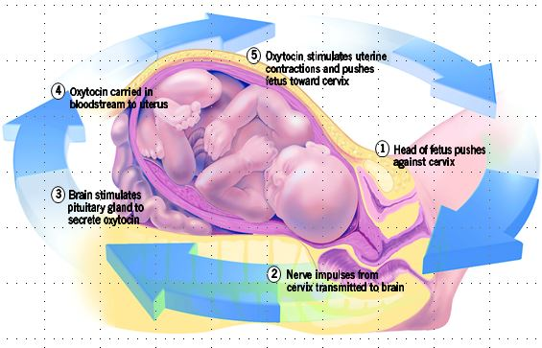

Slide 22
Thank You

